Slide 1
CAPSTONE PROJECT- THE BATTLE OF THE NEIGHBORHOODS
Data Science Certification by IBM/Coursera

Slide 2
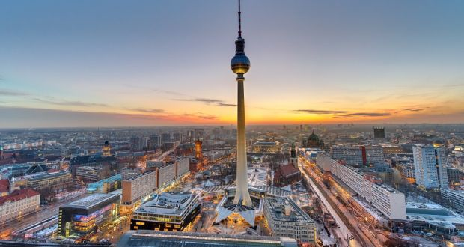
Introduction
Prospects of starting a Restaurant/Bar by inspecting the Borough of Berlin
What is the best place to open a Restaurant/Bar in Berlin

Slide 3
Target Audience
The primary target audience for this project are definitely the entrepreneurs who want to open up a new business
Investors who want to invest in good business ideas
Students who are exploring Data Science and are trying to learn the art of telling a story by training, analyzing and learning from a data

Slide 4
Data: Requirements and collection
Zones Data: Collected by web scraping and got Coordinates using Geocoder
Professional Venue Data: Collected using Foursquare by providing a unique category id
Nearby Venues Data: Collected by using Foursquare
Pricing Data: Collected manually from website

Slide 5
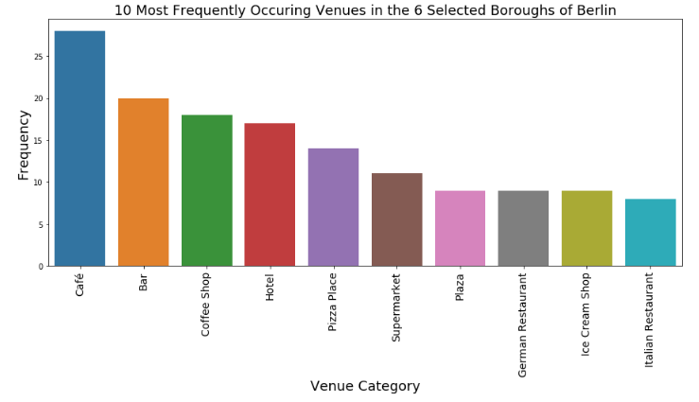
Data Analysis

Slide 6
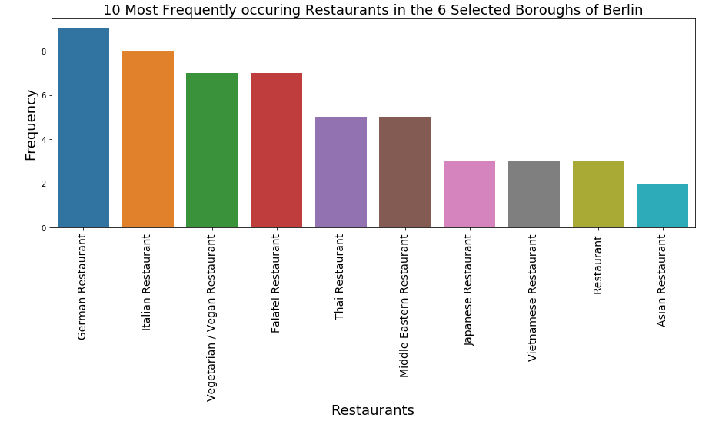
Data Analysis(Cont.)

Slide 7
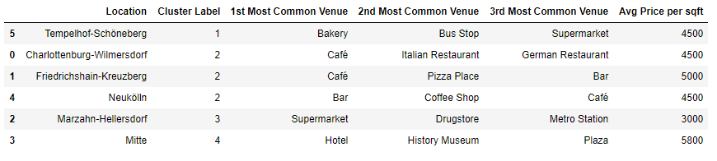
Results
Cluster 1 contains zones whose common venues are not restaurants
Cluster 2 contains zones with top 2 most common venues being Cafe
Cluster 3 contains zones with whose common venues are of other categories
Cluster 4 again contains zones whose common venues are of other categories

Slide 8
Conclusion
Cafe is the most fesible option
Cafe with bar might be another option.

